Slide 1

CLI BASED CHAT TOOL
Created by : Gaurang Shekhar Sharma
University Roll number : 2018801
Course : Btech CSE
Section : F
Mentor : Mr. Yuvraj Joshi (Associate Professor Deptt of CSE)

Slide 2

Converse with Command: Unleashing the Power of Python for CLI-Based Chatting

Slide 3

Introduction
Welcome to the world of CLI chatting with Python! In this presentation, aim is to create a user-friendly chat application that allows users to connect to a central server and exchange messages with each other seamlessly. By utilizing socket programming and multithreading, the application ensures concurrent connections and synchronized communication. We'll dive into the basics of CLI and Python programming, and explore advanced techniques for building intelligent chatbots that can understand natural language. Let's get started!

Slide 4
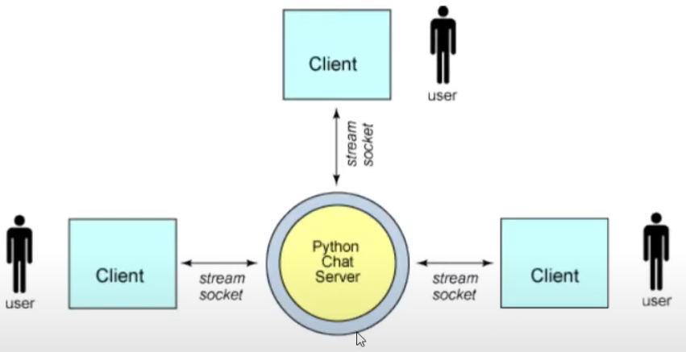
PROBLEM STATEMENT
The objective of this project is to design and implement a chat application that facilitates real-time communication between multiple clients using socket programming in Python. The application should allow clients to connect to a central server and exchange messages with each other. The server should be capable of handling concurrent connections from multiple clients, maintaining a list of connected clients, and broadcasting received messages to all clients except the sender. The application should provide a user-friendly interface, allowing clients to input messages and view the chat history. Additionally, the system should handle client disconnections gracefully, notifying other clients when a client joins or leaves the chat.

Slide 5

Why Python for CLI Chatting?
Python is an ideal language for CLI chatting due to its simplicity, ﬂexibility, and powerful libraries. With Python, you can easily create chatbots that can understand natural language and interact with users in a conversational manner. Python's vast ecosystem of libraries such as NLTK and spaCy make it easy to create intelligent chatbots that can understand the nuances of human language.

Slide 6

CLI Basics
Command Line Interface or CLI, is a text-based interface for interacting with a computer system. Using CLI, users can execute various system commands by typing them in a terminal window. CLI is a powerful tool for developers and system administrators, allowing them to perform complex tasks quickly and efﬁciently.

Slide 7

Python CLI Libraries
Python has several libraries that make it easy to create CLI-based chatbots. Libraries such as Click, Argparse, and Fire provide a simple and intuitive way to create command-line interfaces for Python applications. With these libraries, you can easily create CLI- based chatbots that can respond to user input and execute complex tasks.

Slide 8
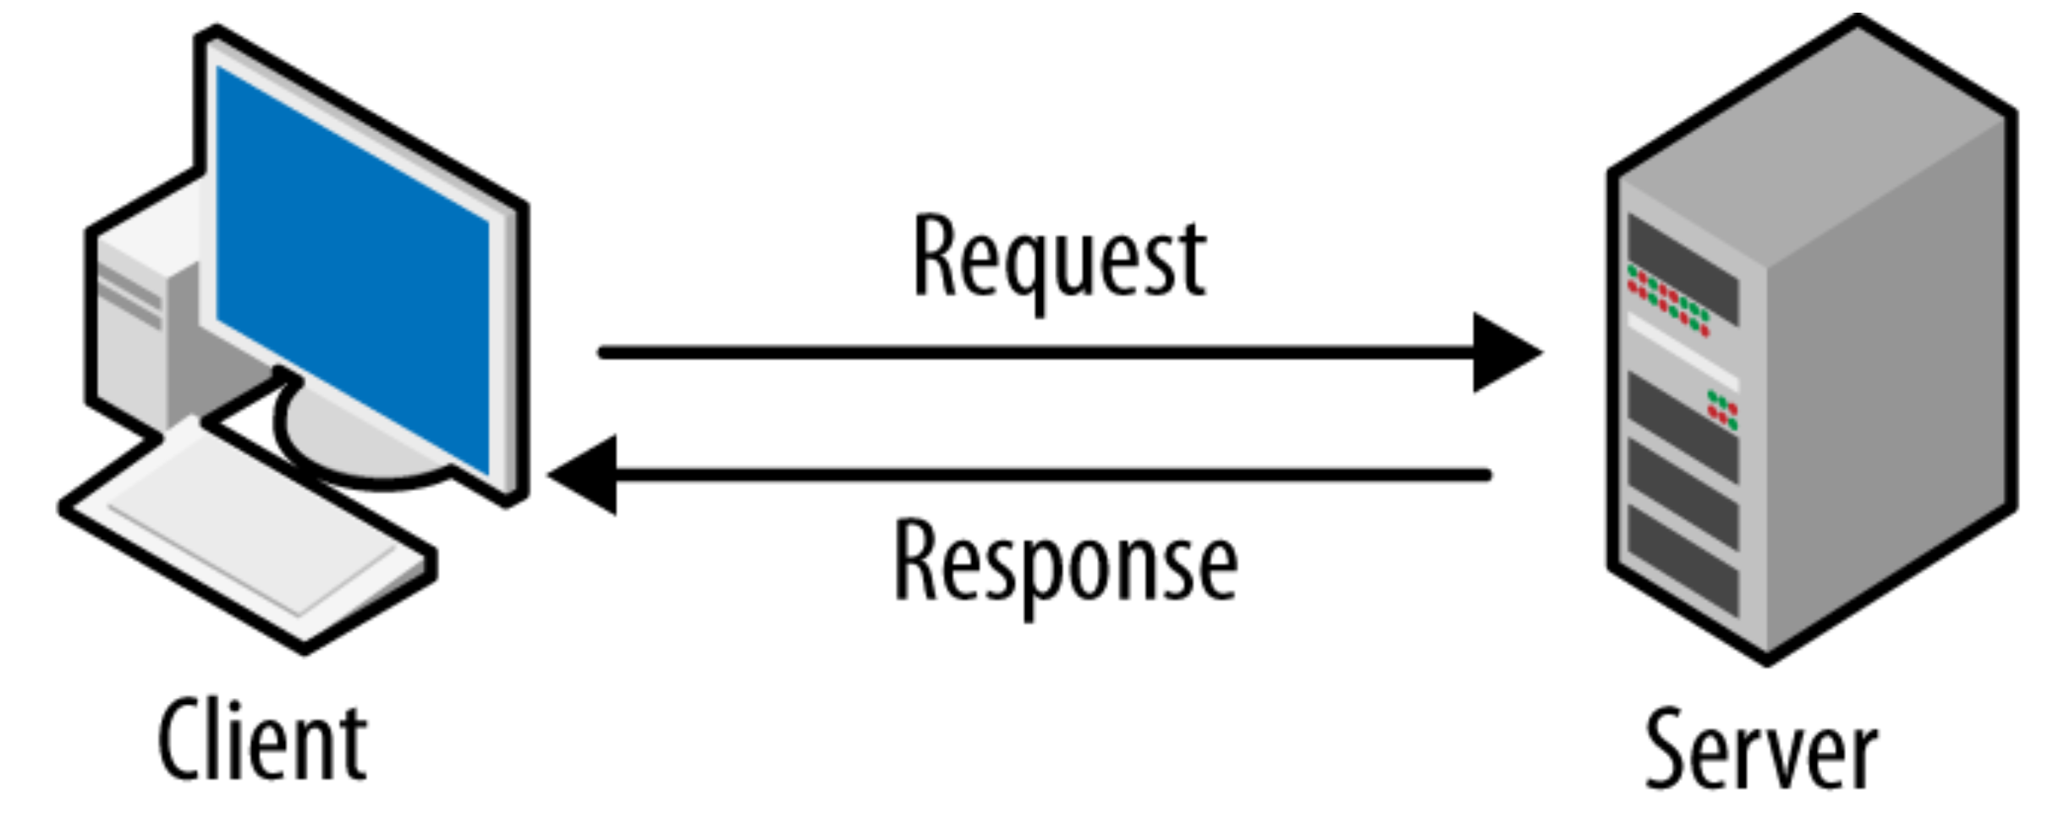
METHODOLOGY
The development of the chat application using socket programming in Python follows a systematic approach to ensure its successful implementation. The methodology includes the following key steps:
1. Requirement Analysis: Understand the specific requirements of the chat application, including the desired features, user interface, communication protocols, and client-server interaction. This step involves gathering user requirements and defining the scope of the project.
2. System Design: Based on the requirements, design the overall system architecture of the chat application. Identify the components, such as the client-side script and server-side script, and define their functionalities and interactions. Determine the data flow, message formats, and error handling mechanisms.
3. Implementation: Develop the client-side script and server-side script in Python, following the design specifications. Implement the socket programming logic to establish connections, send and receive messages, and handle concurrent client connections using multithreading. Ensure the scripts are well-structured, modular, and adhere to best coding practices.

Slide 9
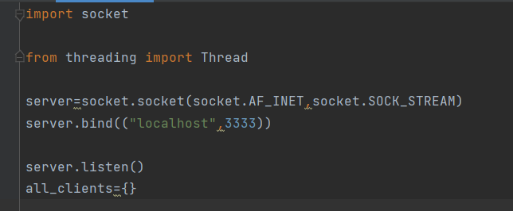
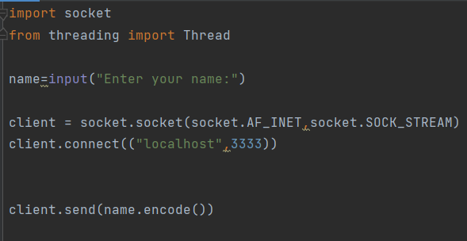
4. Testing: Conduct thorough testing of the chat application to ensure its functionality and reliability. Test various scenarios, such as multiple client connections, message transmission, handling of client disconnections, and error scenarios. Perform unit testing, integration testing, and system testing to identify and resolve any bugs or issues.
5. User Interface Design: Design a user-friendly interface for the client-side script. Create an interactive console-based interface that allows users to input messages, view the chat history, and receive notifications. Ensure the interface is intuitive, responsive, and easy to navigate.
6. Documentation: Prepare comprehensive documentation that includes the project overview, system architecture, installation instructions, usage guide, and any other relevant information. Document the design decisions, implementation details, and troubleshooting steps. This documentation will serve as a reference for future maintenance and enhancements.

Slide 10
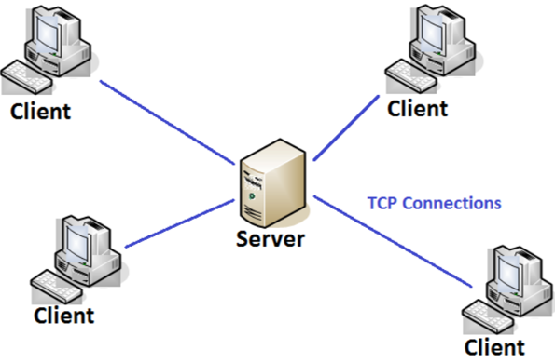
IMPLEMENTATION AND RESULTS
The implementation of the chat application using socket programming in Python involves developing both the client-side and server-side scripts.
To run the chat application:
1. Save the client-side script as "client.py" and the server-side script as "server.py" in separate files.
2. Open two command prompt (terminal) windows.
3. In one window, navigate to the folder containing "server.py" and run the command `python server.py` to start the server.
4. In the other window, navigate to the folder containing "client.py" and run the command `python client.py` to start a client.
5. Repeat step 4 to start additional clients and establish connections with the server.
6. Enter a name for each client when prompted by the client-side script.
7. Clients can now send and receive messages through the chat application.
Note: Make sure the server is running before starting the clients. Additionally, ensure that the server is accessible to the clients (e.g., running on the same machine or accessible via the network). Adjust the host and port values in the code if needed.
This implementation provides a basic foundation for a chat application using socket programming in Python. Further enhancements, such as user interface improvements, message formatting, or additional features, can be added based on specific requirements.

Slide 11
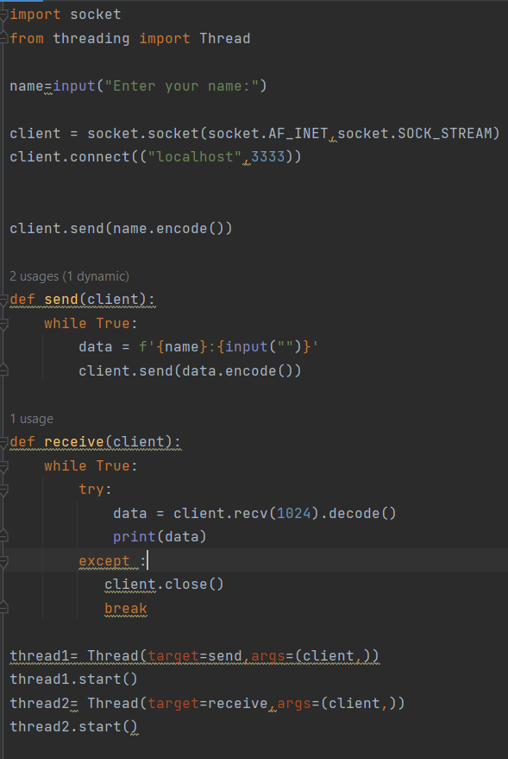
Client implementation

Slide 12
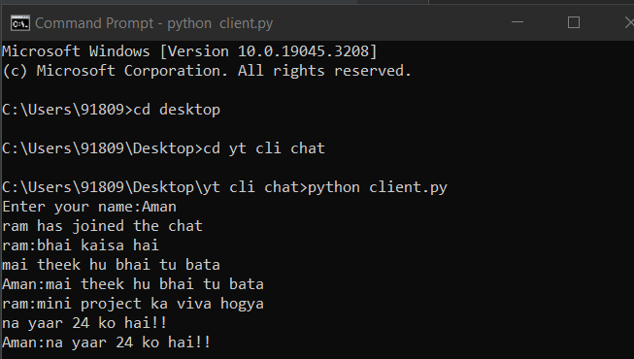
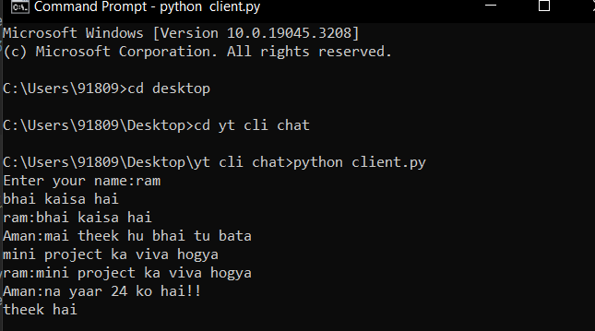
Result

Slide 13
Conclusion
In conclusion,The chat application developed using socket programming in Python provides an efficient and reliable solution for real-time communication between multiple clients. The project successfully achieves its objective of creating a user-friendly chat platform that allows clients to connect to a central server and exchange messages seamlessly.

